Slide 1
Data Visualization
John Cruz
DATA 607

Slide 2
Topics Ahead
Data Visualization Rules
“Good” Examples
Fox News
Florida Dept of Law Enforcement
Purdue Pharma
NBC News
Reading recommendations
References

Slide 3
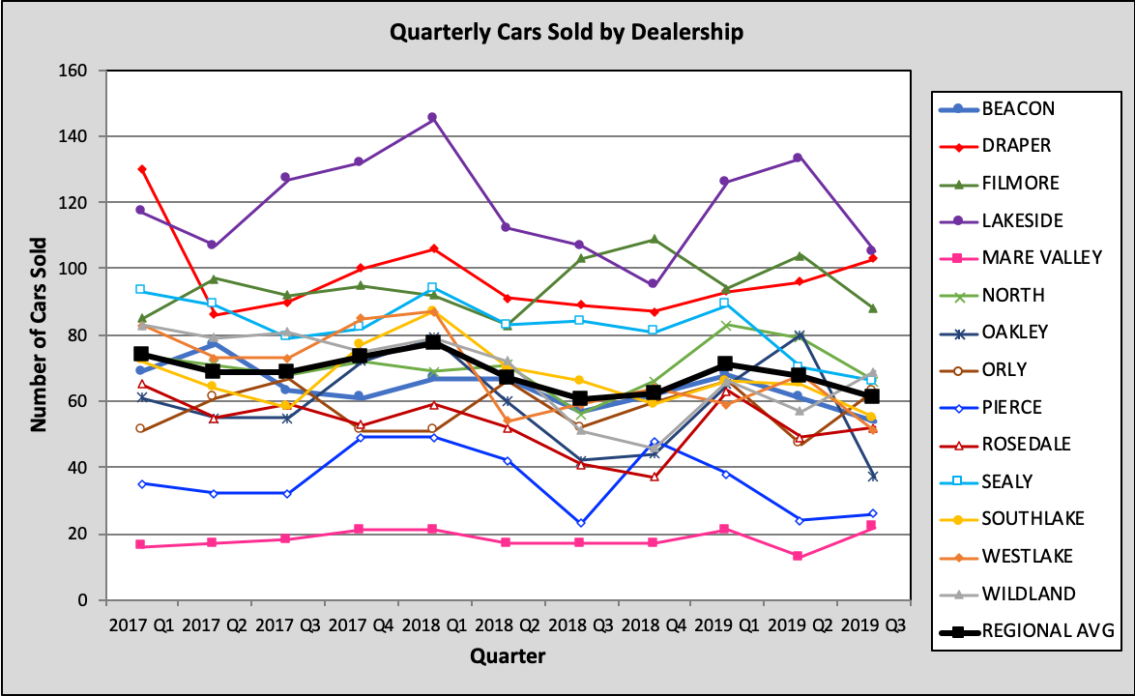
Rule #1: Does it tell a story?
Graphics should be clear on their own
Cole Nussbaumer Knaflic
Source
[1] Storytelling with Data

Slide 4
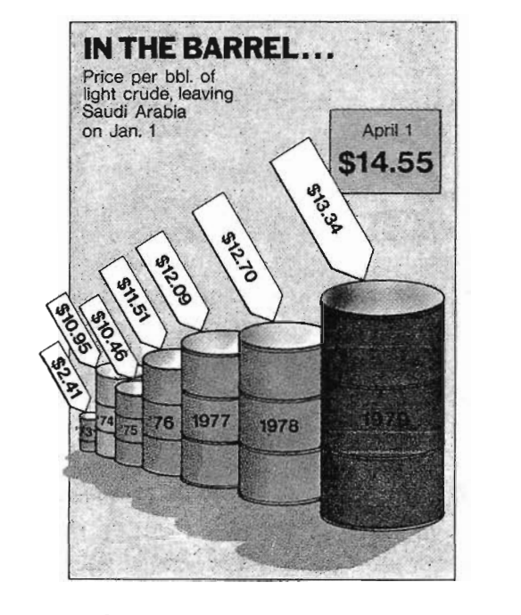
Rule #2: Does the chart deceive us?
Charts should not misrepresent the truth
Edward Tufte’s Lie Factor
lie factor =
graphic effect size
data effect size
4280 %
4280 %
=
= 9.4
(13.34-2.41) * 100
454 %
Edward Tufte
Source
[2] VDQI, page 62

Slide 5
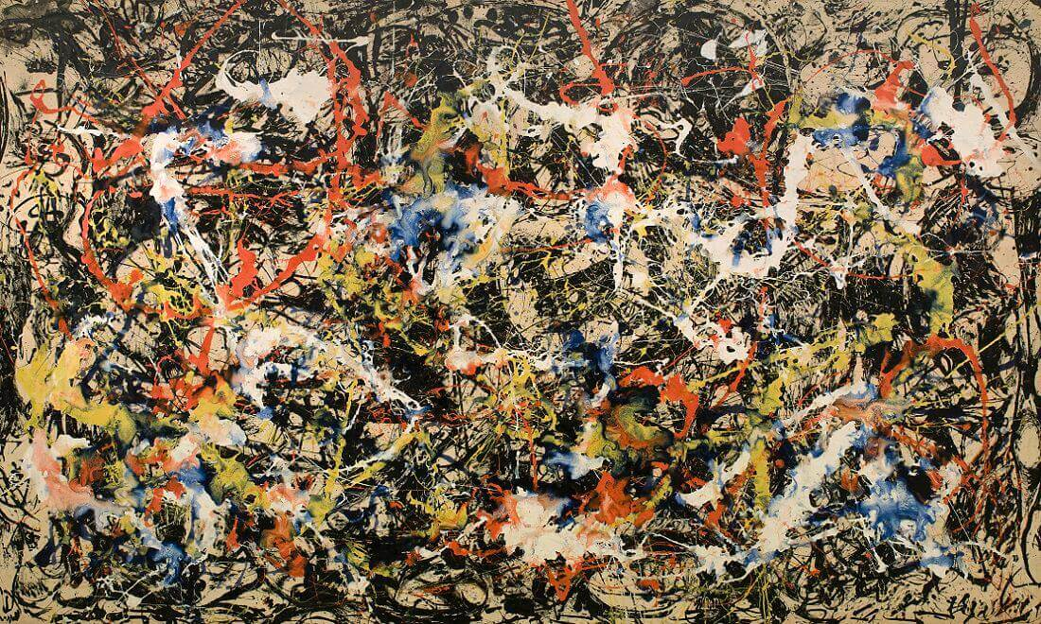
Rule #3: Keep it Simple
Minimize data ink
Reduce chart junk
Jackson Pollock
Convergence, 1952

Slide 6
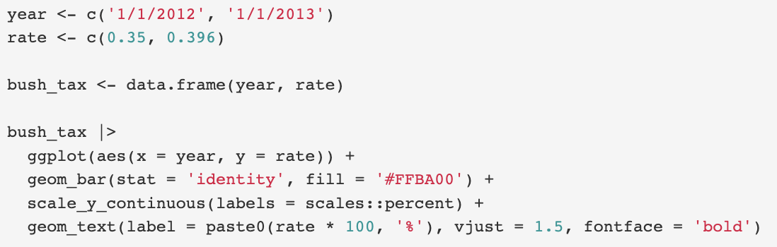
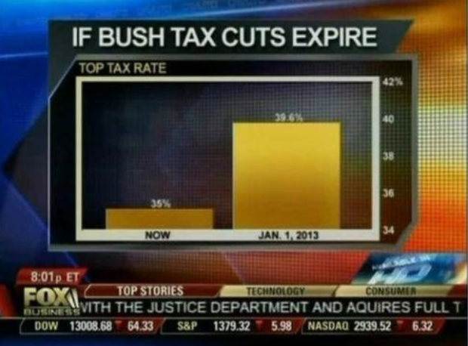
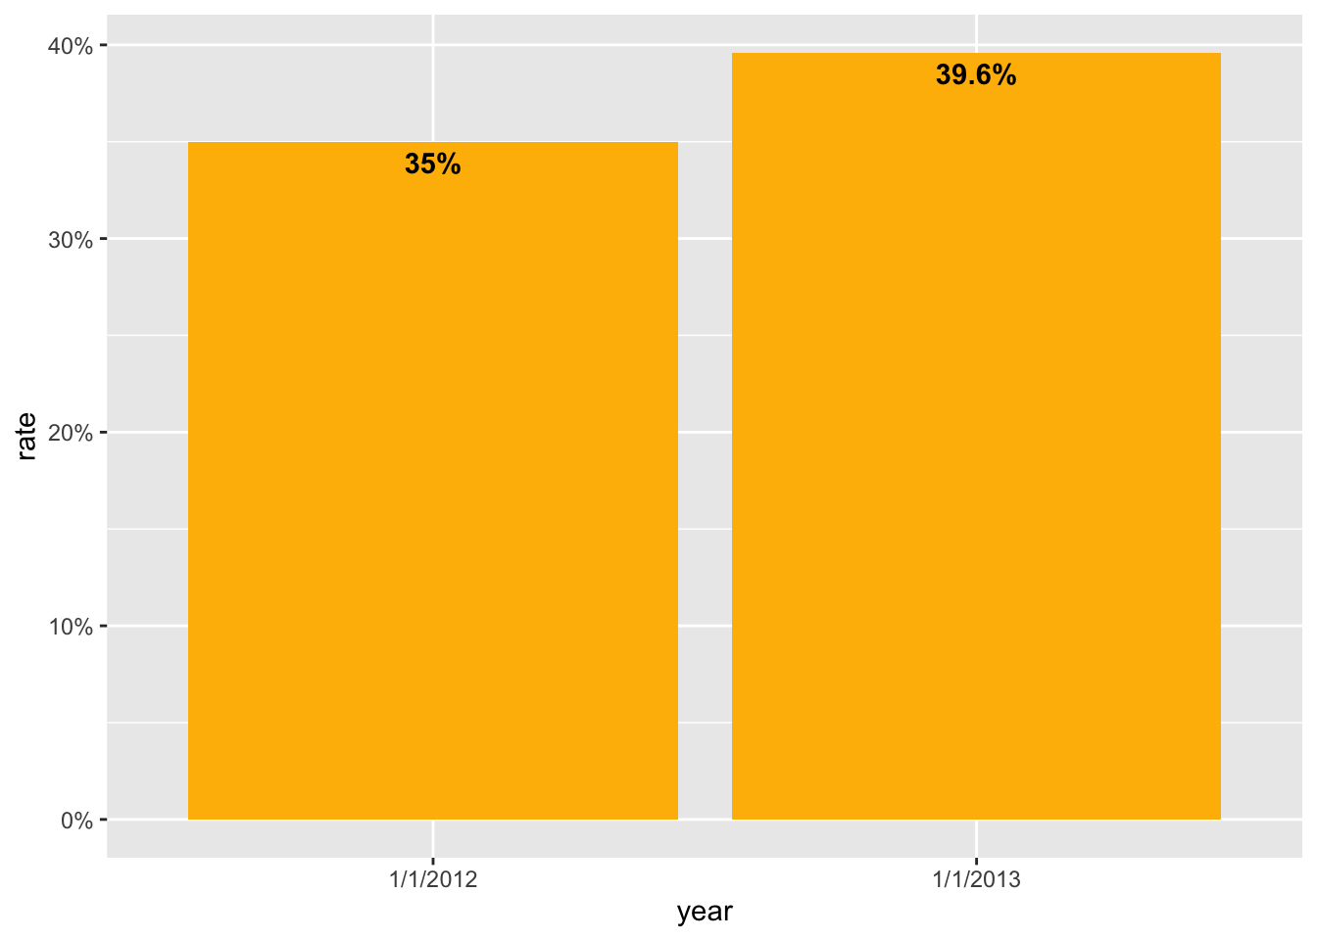
Fox News
Source
[3] Flowing Data

Slide 7
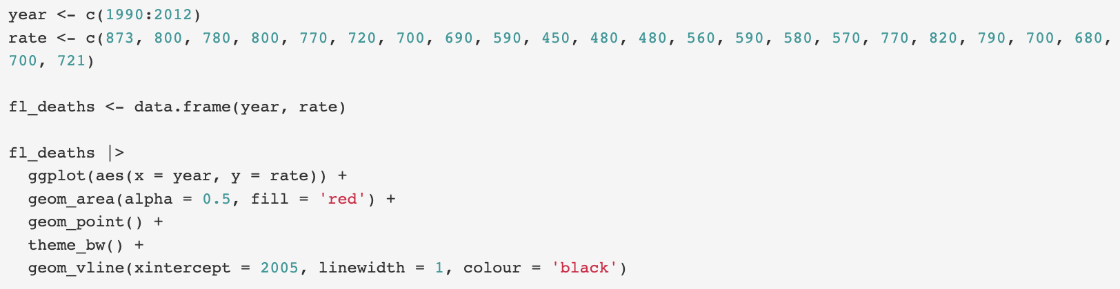

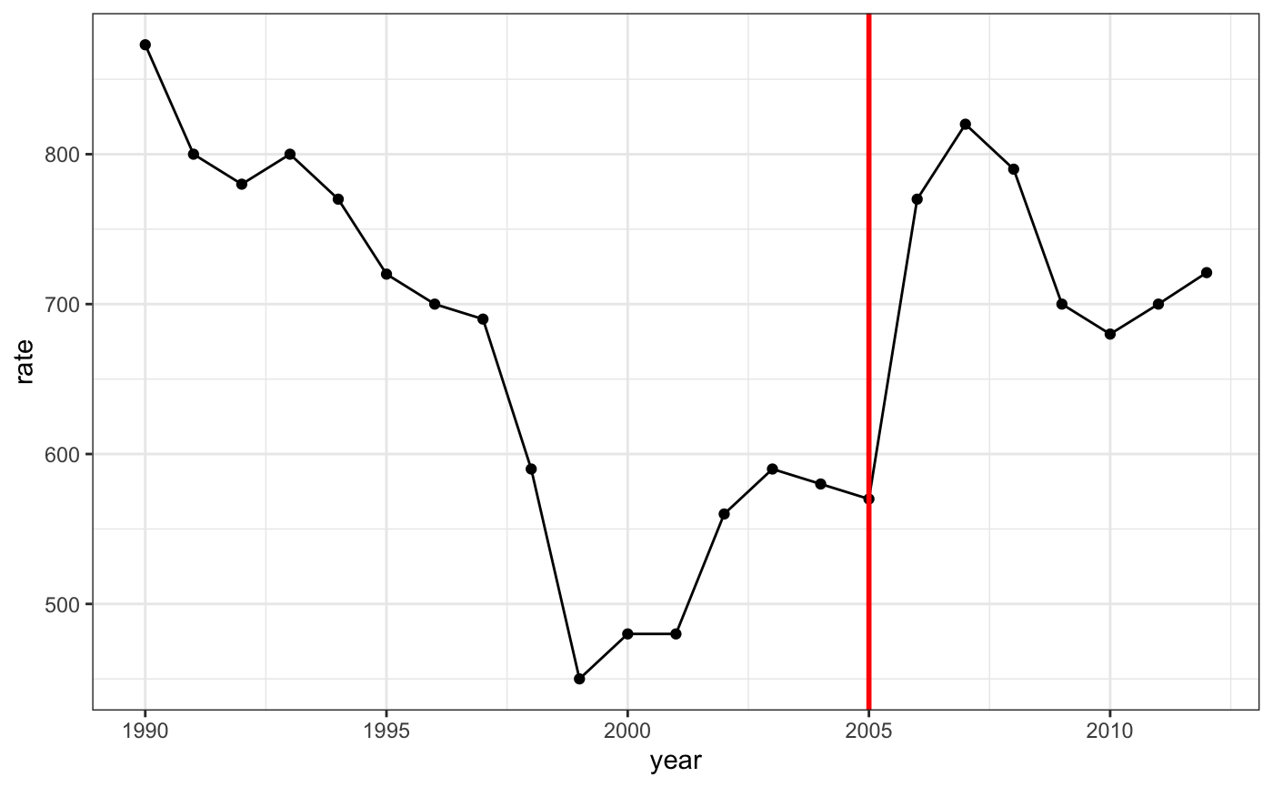
Florida Dept. of Law Enforcement
Source
[4] Fast Company

Slide 8
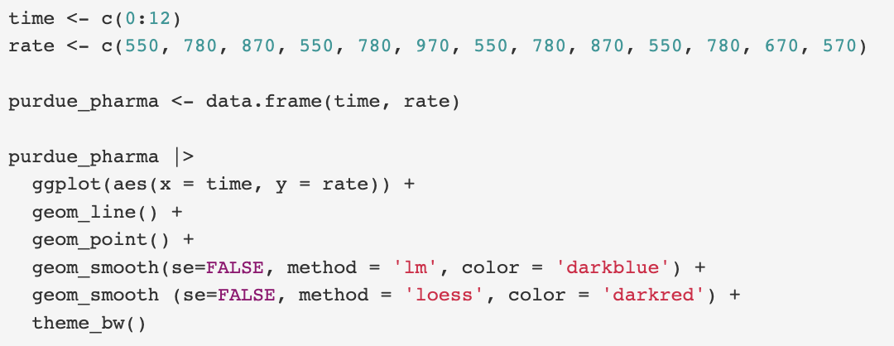
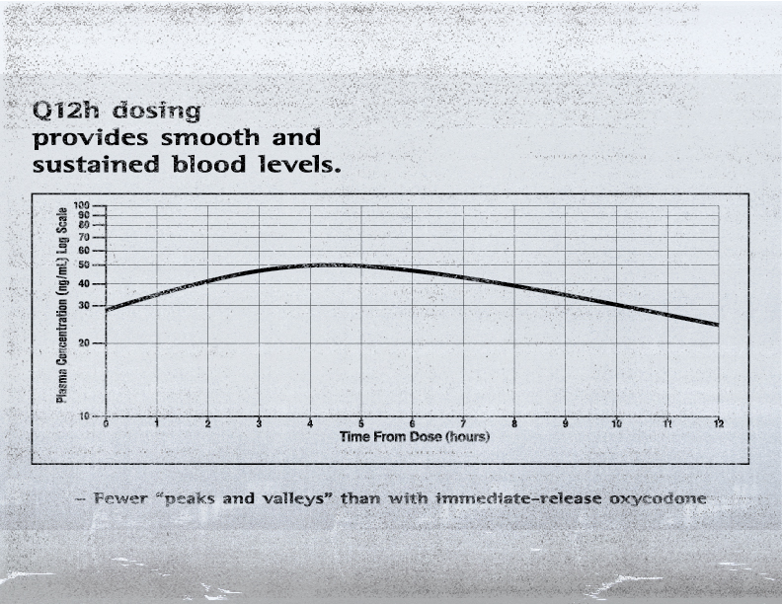
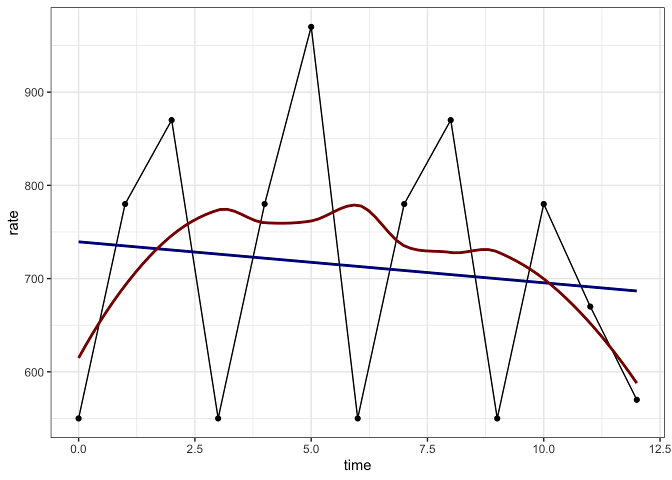
Purdue Pharma
Source
[5] Office of the Attorney General of CA

Slide 9
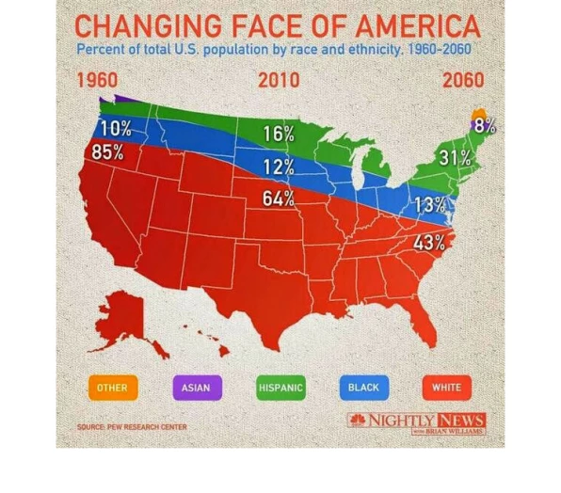
NBC News
Source
[6] Business Insider

Slide 10
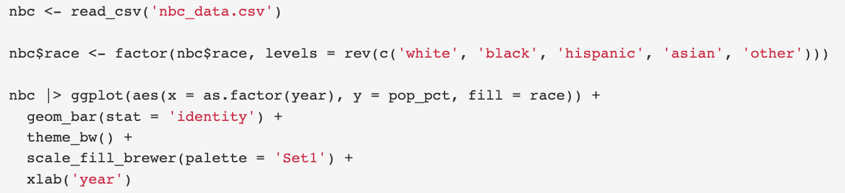
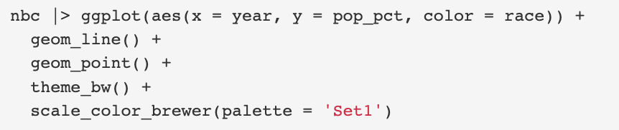
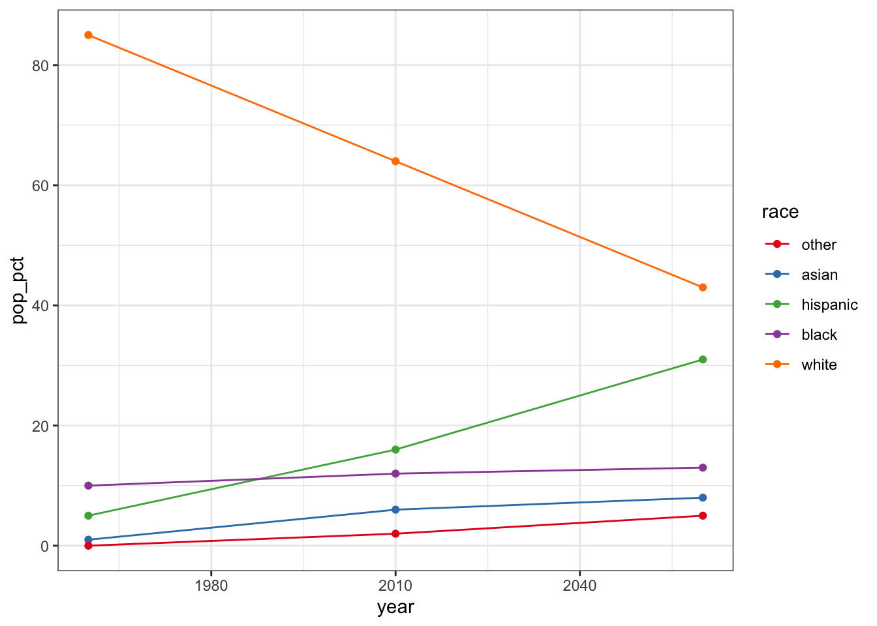
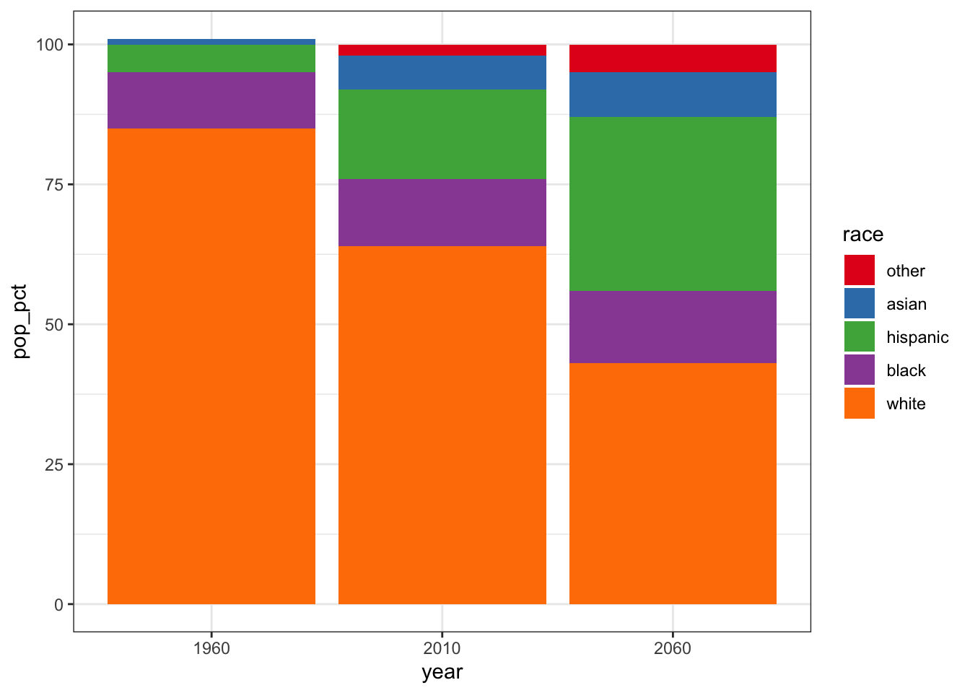

Slide 11
Recommended Readings
Storytelling with Data
https://www.storytellingwithdata.com/
Fundamentals of Data Visualization
https://clauswilke.com/dataviz/index.html
The Visual Display of Quantitative Information
https://www.edwardtufte.com/tufte/books_vdqi
Tableau Public
https://public.tableau.com/app/discover

Slide 12
References
https://community.storytellingwithdata.com/exercises/one-little-changeand-a-redesign/images
https://www.edwardtufte.com/tufte/books_vdqi
https://flowingdata.com/2012/08/06/fox-news-continues-charting-excellence/
https://www.fastcompany.com/3029318/the-worst-infographic-of-2014-so-far
https://oag.ca.gov/system/files/attachments/press-docs/53464758.pdf
https://www.businessinsider.com/gun-deaths-in-florida-increased-with-stand-your-ground-2014-2

